Slide 1

MEET THE TEACHER
September 2026
Year 1

Slide 2


Brindishe Federation Priorities 26/27

Slide 3
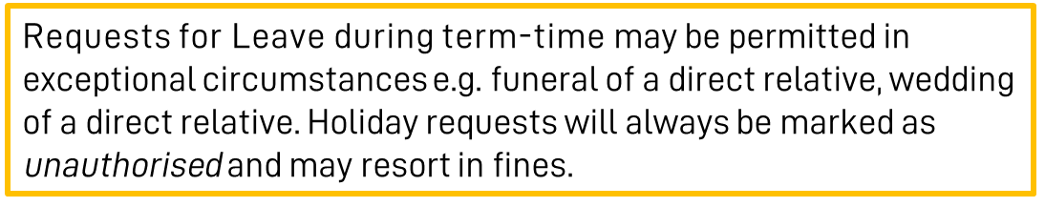
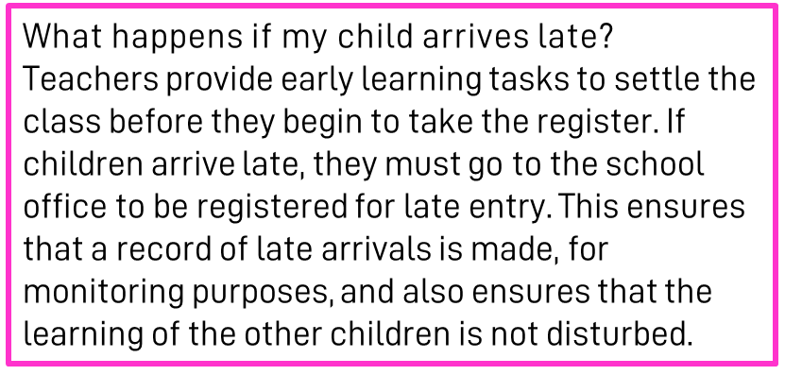
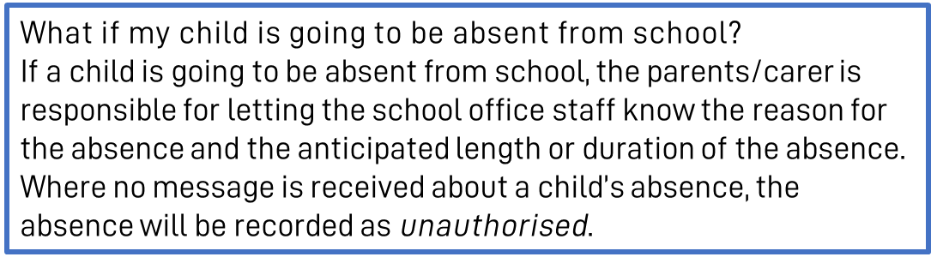
Attendance & Punctuality
At Brindishe Schools we believe that good attendance and punctuality are essential. Research shows that children who attend school regularly do better at school and make better progress.
Brindishe Manor
Start Time - Gates Open 8.35am/Gates Close 8.45am
Children are expected to be in school by 8.45am. Children arriving after 8.45am will be marked at ‘late’
Finish Time - School Ends 3.15pm

Slide 4
Attendance & Punctuality
Planned Absences
Please ensure that you inform the office of any planned absences in advance, either by email or telephone e.g. Eid, Secondary School visits/tests.
Last Minute Collection Arrangements
Please telephone the school office before 2pm if collection arrangements for your child have changed for that day.
Pick-Up Passwords
If another adult is collecting your child, they will be required to provide a ‘pick-up’ password before they can take your child home. Please ensure you pass this onto the school office when you inform them of alternative collection arrangements.

Slide 5
Communication Channels
Absent Reporting
To report your child absent please call or email before 8.30am. Please call the school on each day of your child’s absence.
Brindishe Manor - 0208 852 0852- info-BM@brindisheschools.org
Message for Class Teacher or a member of the Senior Leadership Team
Email info-BM@brindisheschools.org – please mark ‘For Attention Of …’ followed by the name of the member of staff e.g. FAO Mrs Porter
Extended Services – Breakfast and Tea Club
Claire Dawson (Interim Extended Services Manager) can be contacted at extendedservices-BM@brindisheschools.org
Telephone on: 020 8852 0852
General Enquiries
0208 852 0852 – info-BM@brindisheschools.org
Our preferred method of communication is via email if you cannot find the answer on the school website. Emails will be responded to within 48 hours so if it is an emergency, please call the school directly.
Radish and School Meals
Clare Doran - schoolmeals@brindisheschools.org
M: 07943 041790

Slide 6


Arbor
What can you do on the Arbor App?
Add and amend information
See school notices
Update child’s information
Update your information
See your child’s lessons
See your child’s attendance
Retrieve an attendance summary for week, term and/or the year
Book a parent/carer consultation
Sign your child up for clubs, trip, visitors and music
Pay for trips and clubs (where needed)
See account balances

Slide 7

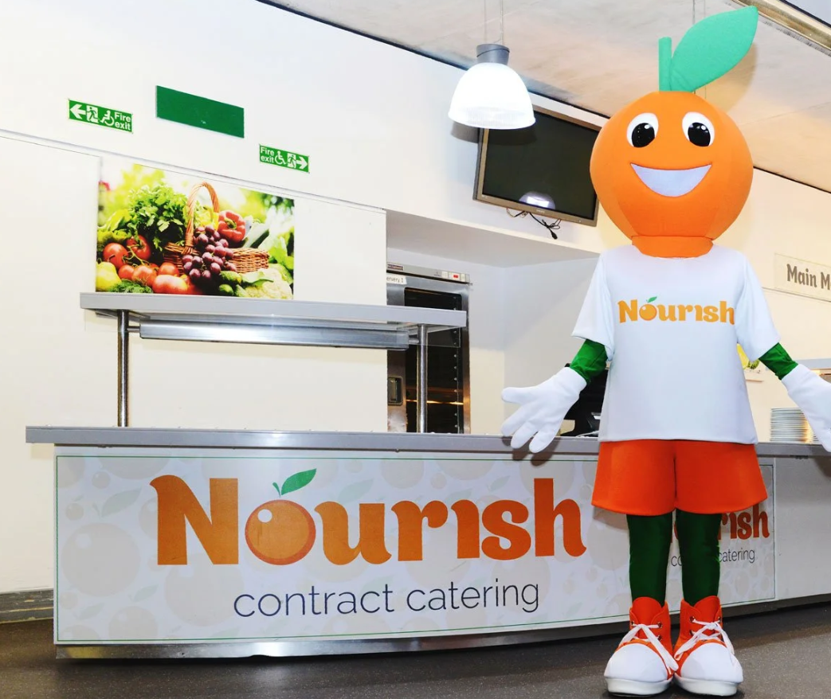
Nourish (school meals) and FSM
Nourish is a friendly family-led school caterer with bags of initiative and a love of good food. They believe every child needs a satisfying meal at lunchtime, fuelling them for the afternoon ahead. Nurturing the importance of a healthy and balanced diet, they provide a nutritious meal every day to nourish from within.
Each day the children will have a choice of:
Three main dishes
A pudding OR a choice of either cheese/biscuits or yoghurt
Freshly baked bread
Fresh fruit
Nine salad choices each day from the salad bar
Milk and water
Cost per day: Free under the current Mayor of London’s Scheme
Autumn Term Menus can be found on the school website.

Slide 8
Key Dates
Term Dates: 2026–2027
Autumn Term
Thursday 3rd September 2026 to Friday 23 October 2026
Half-term: Monday 26 October 2026 to Friday 30 October 2026
Monday 2 November 2026 to Friday 18 December 2026
Spring Term
Tuesday 5 January 2027 to Friday 12 February 2027
Half-term: Monday 15 February 2027 to Friday 19 February 2027
Monday 22 February 2027 to Wednesday 24 March 2027
Summer Term
Monday 12 April 2027 to Friday 28 May 2027
(the early May bank holiday will be taken on 3 May)
Half-term: Monday 31 May 2027 to Friday 4 June 2027
Monday 7 June 2027 to Wednesday 21 July 2027
INSET DAYS
Wednesday 2 September 2026
Friday 27 November 2026
Monday 4 January 2027
Thursday 25 March 2027
Thursday 22 July 2027
We will endeavour as much as practically reasonable, to provide you with dates well in advance. Please see our ‘Key Dates for Parents/Carers’ document on Weduc. Class teachers will give you at least 2 weeks' notice of a planned Educational Visit.

Slide 9
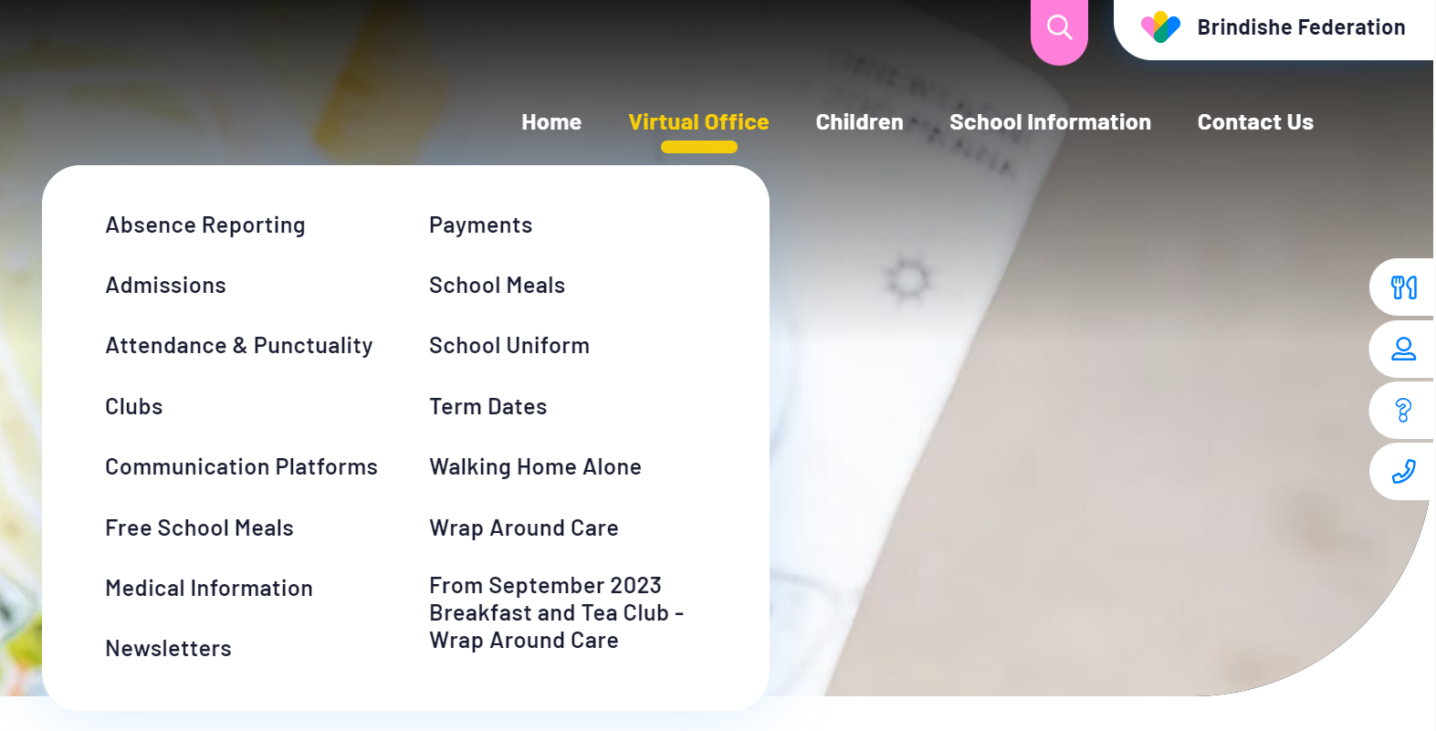
Website
The Brindishe Federation and school website provides all key information needed for parents/carers.
The website includes:
School Policies, including Attendance, Admissions, Complaints and RSHE
Meet our Governing Body
Nourish Termly Menus
The Brindishe Curriculum and Year Group Overviews
Data and Performance Measures
External Reviews – Ofsted
Typical School Day
How to support your child at home
Clubs and Wrap Around Care
Weekly federation and school newsletters
Reading
Equalities & Diversity
PTAs
….. And much more.
The website also provides a virtual office function – please visit the virtual office for all your daily enquiries and needs.

Slide 10
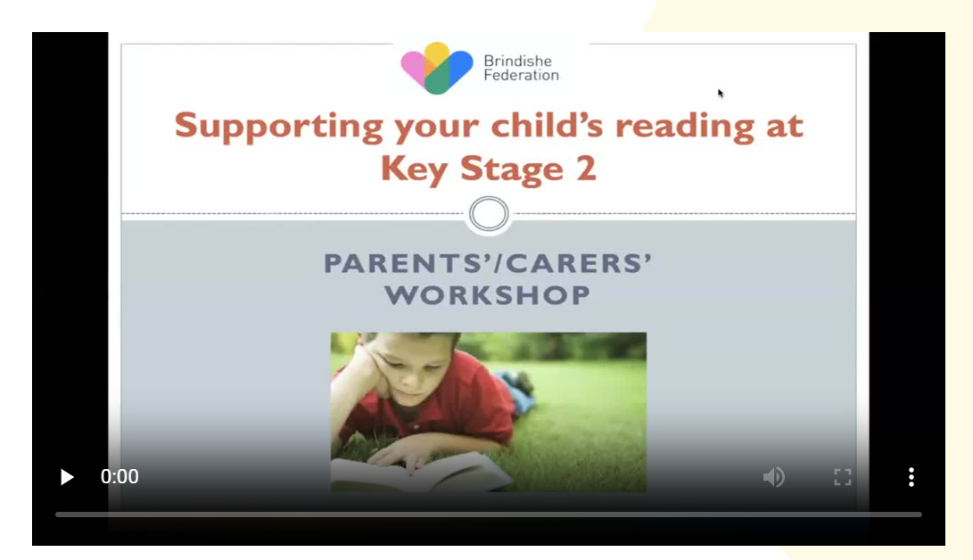
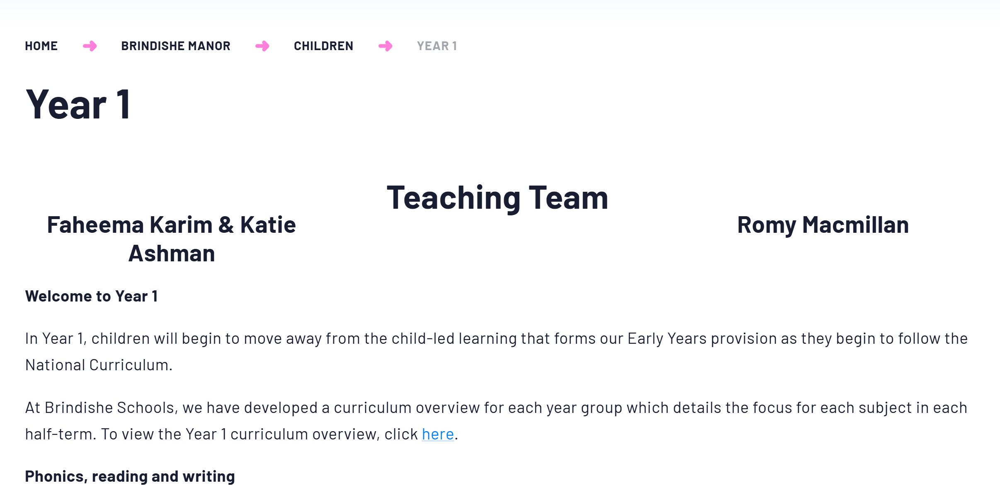
Website – Class Pages
Curriculum Overviews
Videos to support learning
Core Subject Specific Information (Maths and English)
Spelling Lists
Teaching Teams
Newsletters

Slide 11
Year 1 Phonics Screening Check
The Year 1 phonics screening check is not a formal test, but a way for teachers to ensure that children are making sufficient progress with their phonics skills to read words and that they are on track to become fluent readers who can enjoy reading for pleasure and for learning.
It is taken individually by all children in Year 1 in England, and is usually taken in June. It is designed to give teachers and parents/carers information on how your child is progressing in phonics. It will help to identify whether your child needs additional support at this stage so that they do not fall behind in this vital early reading skill.
It checks that your child can:
Sound out and blend graphemes in order to read simple words.
Read phonically decodable one-syllable and two-syllable words, e.g. cat, sand, windmill.
Read a selection of nonsense words which are referred to as pseudo words.
The check is not about passing or failing but checking appropriate progress is being made. If children do not reach the required standard, then the teacher will be in touch to discuss plans and offer additional, tailored support to ensure that your child can catch up. Children progress at different speeds so not reaching the threshold score does not necessarily mean there is a serious problem. Your child will re-sit the check the following summer term.
For the last few years, the threshold mark (or pass standard) set by the government has been 32 correct answers out of 40.

Slide 12
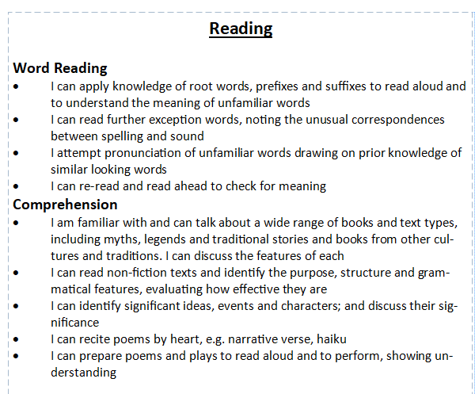

End of Year Expectations
Overwhelming response and feedback from parent/carer survey indicated a want and need for clearer end of year expectations for your children.
Today, all families will receive the ‘End of Year Expectations’ booklet. We hope this will support you in knowing where how your child is progressing and how to support at home.

Slide 13
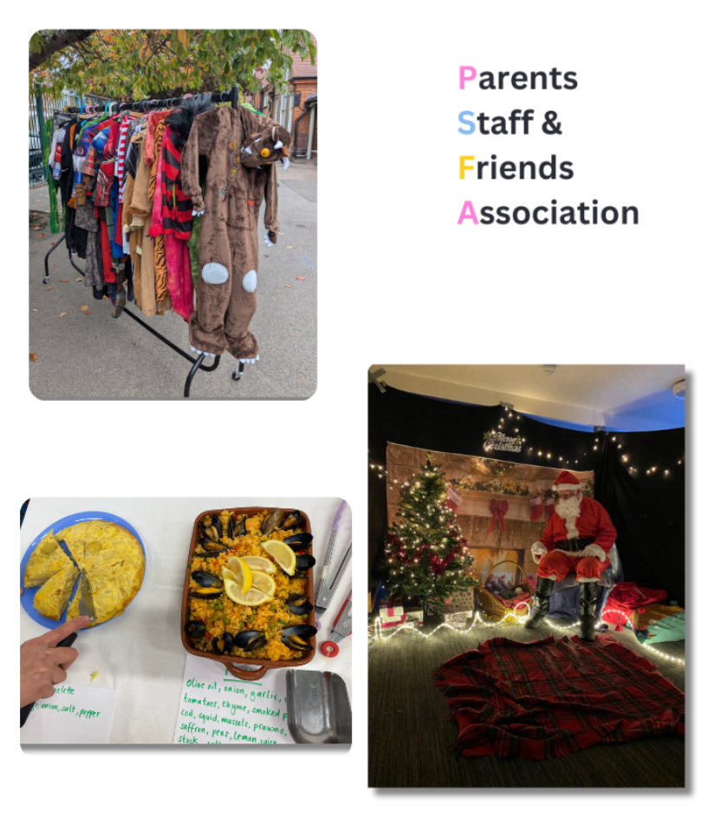
How can school and home collaborate and work together?
Join our PTA – Brindishe Friends Group – Over £20,000 raised last year which contributed to the hall acoustics and will fund the OPAL Playground initiative.
Trips and Visitors can be paid for online via Arbor – without your contributions trips and enrichment opportunities cannot go ahead.
We strive to communicate with you as much as possible and in a timely manner. Please remember that communication channels are via info-BM@brindisheschools.org.
Engage with Arbor and the school website as much as possible, especially when paying for clubs, trips and music.

Slide 14
MEET THE YEAR GROUP TEAM

Slide 15
Meet the Team
Teachers:
Goldsworthy- Miss McMillan
Kusama- Ms Karim (Tuesday, Wednesday Thursday) and Miss Ashman (Monday - Friday)
Teaching Assistants:
Goldsworthy- Mrs Young
Kusama- Mr Jones
PPA Cover:
Goldsworthy- Miss Cooke

Slide 16
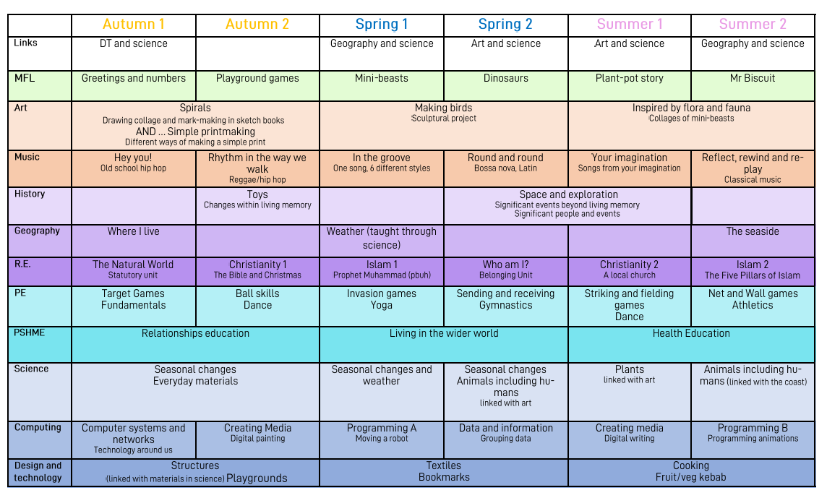
Yearly Overview

Slide 17
Autumn Term Overview
English:We will be focusing on our letter formation and using our phonics to help us write words. To practice these skills we will have lots of opportunity to write labels and captions to describe the learning we are doing in the classroom .
Maths: We will be counting, sorting and ordering numbers. We will also look at how numbers are organised using a number line. We will be learning about fact families (e.g. all the ways to make 8) and learning our number bonds to 10.
Science: We will be learning about seasonal change through observing, classifying and describing. This will include looking at leaves, plants and the weather to identify signs of Autumn.
Geography: We will be learning about where we live and where we go to school. We will also be finding out about the human and physical features of geography in our area.
Art: Our theme is ‘Spirals. With a focus on drawing, collage and mark making.
Music: Our unit of work is called ‘Hey You!’, with a focus on old– school hip-hop. We will learn how to use our voices expressively and use instruments to perform a piece of music.
PE: This half term we will be focusing on target and team building games.
PSHME: Focusing on friendships. This will include focusing on being kind, inclusive and resolving low level disagreements.
RE: We will be learning about ‘The Natural World’ and how important this is to Christianity, Islam and Judaism.

Slide 18
PE Expectations and dates
PE days:
Goldsworthy:
Indoor: Wednesday
Outdoor: Friday
Kusama:
Outdoor: Wednesday
Indoor- Thursday
Please make sure that on these days, your child is wearing suitable clothing. Such as leggings, tracksuit bottoms, shorts (in the warmer days!), t-shirts etc.
Please do not dress them in a dress or wearing tights and please no laces on their shoes! We take off socks and shoes for indoor PE and this makes it very tricky for them to independently get them on and off.

Slide 19
Home-Learning Expectations
Year 1 children will be given tasks to do online:
Weekly maths activity uploaded on SumDog
Weekly Bug Club for all year groups
Half-termly project linked to termly theme
Please read with your child as much as often.
In school children will be read to every other week in groups. Some children maybe read to more often and then every other week.

Slide 20
How parents/carers can support at home
At home, please continue to read as often as possible with your child! This is so important for them to continue building up their fluency and comprehension.
Encourage them to practise their writing, this can be writing cards for family members, helping with a shopping list or labelling their pictures! In year 1 we are still spelling using our phonics, so don’t worry if their spelling looks a bit unfamiliar, we want to see them using their phonics to sound out the words!
Please also keep encouraging maths at home, this can be through everyday counting games, such as counting different objects on their way to school. It is also important for them to keep building up their understanding of number bonds, one more and one less than.
Please just ask us if you need any idea on how to help with this at home ☺

Slide 21
How to contact us
Class teachers are always available for brief informal chats on the playground at the end of the day.
For more formal and longer meetings or phone calls, please email info-BM@brindisheschools.org and mark the email ‘For the Attention Of….’ followed by the adults/class teachers name e.g. FAO Ms Dougan.

